Slide 1

Afonso Ferreira Team Manager 113480
Pedro Ponte DevOps Master 98059
Ricardo Antunes Architect 115243
João Neto Product Owner 113482

Slide 2
INTRODUCTION
MediSync is a multi-layered service that helps with hospital management by integrating various functionalities that help with room/patient management and provide real-time patient information to help nurses and doctors deliver optimal care.

Slide 3

MAIN OBJECTIVES
PATIENT
MONITORIZATION
INCREASE STAFF COORDINATION
IMPROVE HOSPITAL
ORGANIZATION

Slide 4
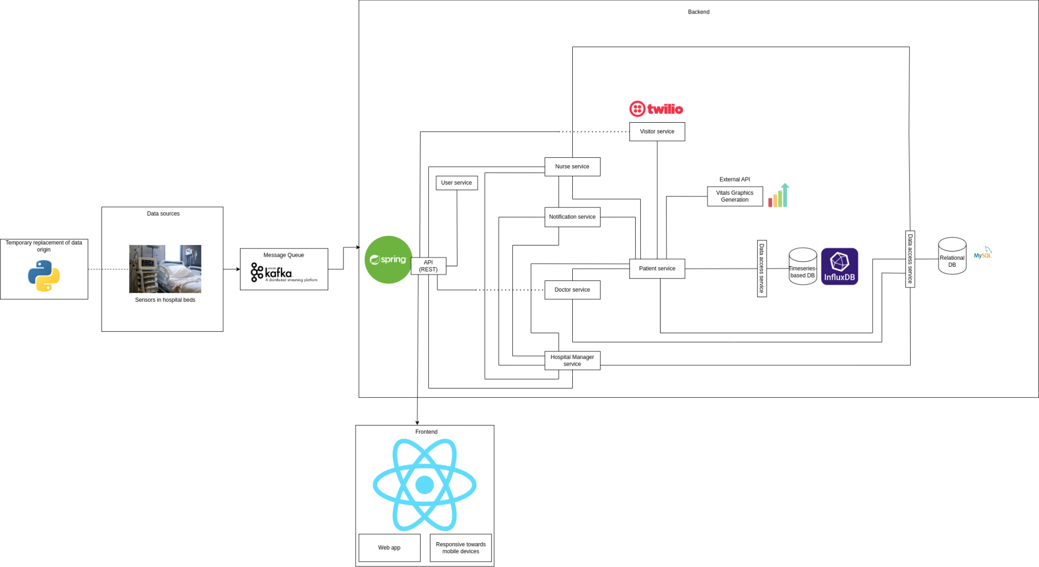
ARCHITECTURE

Slide 5
PERSONA - DOCTOR
As Nadia, a doctor, I want to be able to access a patient’s vital signs history since they arrived at their room so that I can have a bigger picture of how their health progressed since they arrived
As Nadia, a doctor, I want to be able to add information to each patient about necessary medication that needs to be provided by the nurses at a specific time so that they can make sure that the treatment is made while the patients are in their rooms.

Slide 6

PERSONA - HOSPITAL MANAGER
As David, a hospital manager, I want to be able to easily discharge a patient from the hospital so that I can optimize bed/room usage and help patients quickly
As David, a hospital manager, I want to be able to check a map of the rooms and the respective beds, to check bed/room availability and which rooms have patients with contagious diseases so that I can optimize patient placement and hospital management
As David, a hospital manager, I want to be able to register a patient in the system and assign a bed/room and a doctor to the patient so that the hospital can be more organized.
As David, a hospital manager, I want to assign a group of nurses to a specific room and a specific time frame by selecting the room, the time frame and selecting their names from a list of available nurses so that I can ensure adequate staffing and that each room has staff assigned to it.

Slide 7

PERSONA - NURSE
As Peter, a nurse, I want to receive an alert when a patient is discharged, so that I know which rooms/beds need to be prepared.
As Peter, a nurse, I want to see what rooms I am assigned to so that I can be prepared and present in the correct locations to provide care for patients.
As Peter, a nurse, I want to check my assignment schedule for the day so that I can know where I’ll be needed next.
As Peter, a nurse, I want to be able to monitor the vital signs and assigned medication of the patients in the rooms I’m assigned too in real-time so that I can ensure their health status is stable and respond promptly to any changes
As Peter, a nurse, I want to be able to receive an alert if something unusual like a drastic change in heartbeat happens to my patient, so that I can help them as fast as possible.

Slide 8
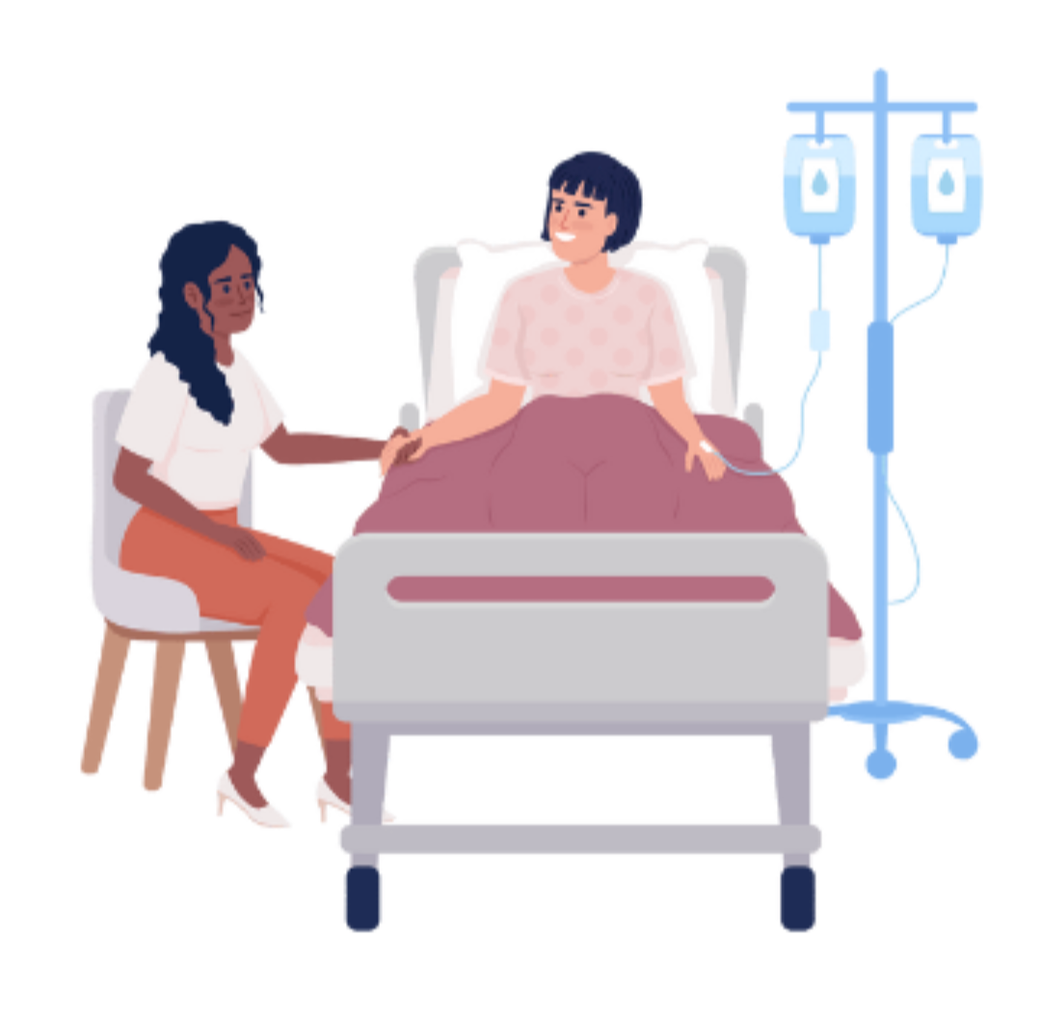
PERSONA - VISITOR
As Maria, a visitor, I want to be able to check where my relative’s room is by receiving a secret code from the application sent by the reception so that when I enter the hospital to visit them, I know where to go.

Slide 9
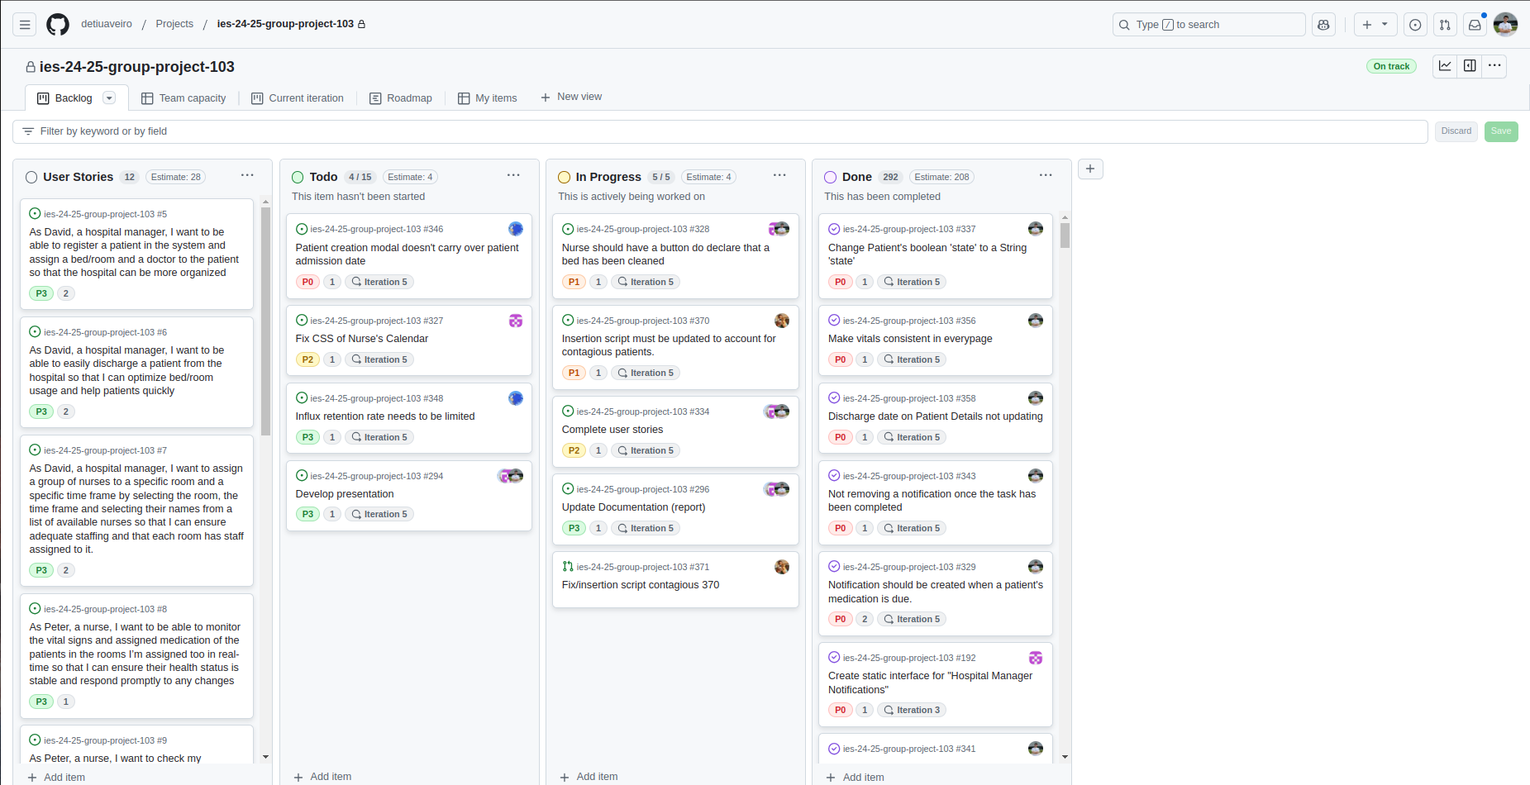
PROJECT MANAGEMENT (BACKLOG)

Slide 10
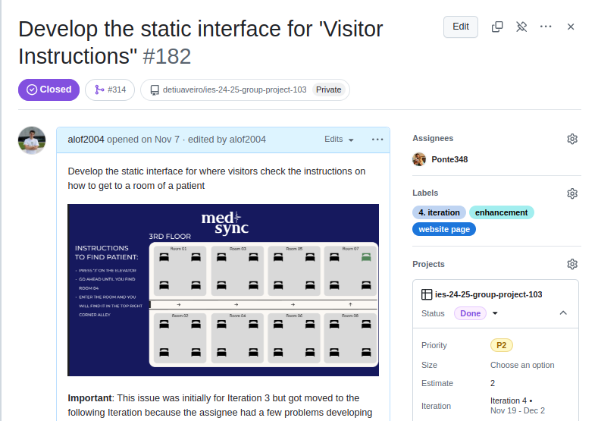
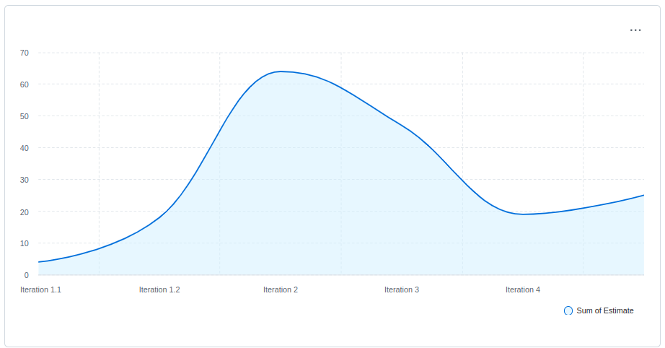
PROJECT MANAGEMENT (BACKLOG)

Slide 11
FUTURE IMPROVEMENTS
Patients and user specifications
Include monitorization
Improve security
Room details
Edit/remove schedules
Doctor schedules
Kafka messages; user requests
Passwords are very simple and endpoints are exposed
Doctor specializations and automatic patient attribution
Create more rooms for specific diseases
Edit and remove schedules
Include schedules for doctors

Slide 12

THANK YOU FOR YOUR ATTENTION
Afonso Ferreira - 113480
Team Manager
Pedro Ponte - 98059
DevOps Master
João Neto - 113482
Product Owner
Ricardo Antunes - 115243
Architect

